Slide 1
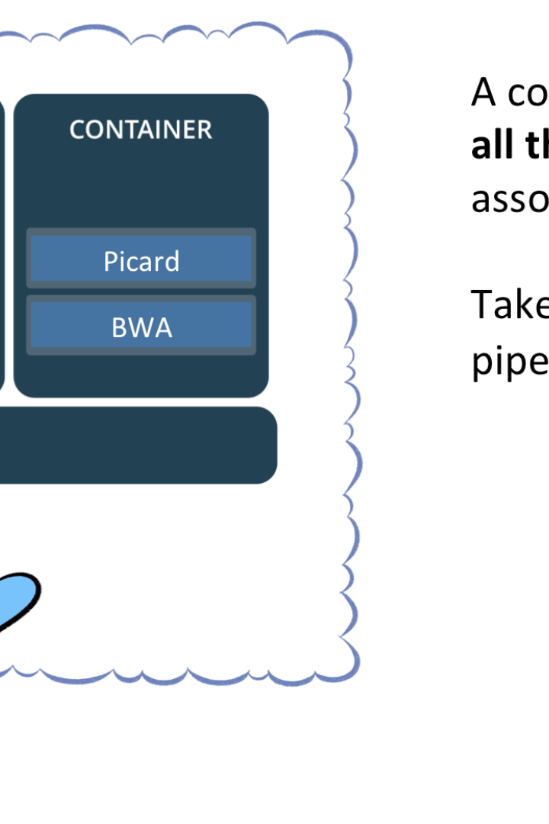
Introduction to Docker
Docker is an open-source platform for developing, shipping, and running applications. Using containers, Docker makes it easy to build immutable images that can be run anywhere.
CS
by Charanjit Singh

Slide 2

Key Features and Benefits of Docker
1
Portability
2
Efficiency
Docker allows developers to create portable applications that can run anywhere, from a laptop to a cloud server or even IoT devices.
Docker enables efficient use of resources, as multiple containers can run on a single machine without conflicts.
3
Isolation
4
Scalability
Docker containers are isolated from each other, ensuring that applications do not interfere with each other's dependencies and configurations.
With Docker, scaling applications horizontally to meet changing demand is easy and efficient by spinning up new instances of the same container.

Slide 3
Docker Architecture
Docker Engine
Docker Registry
Docker CLI
The core component of Docker that allows for creating and running containers.
A repository for storing Docker images, allowing for easy distribution and sharing.
A command-line tool for managing Docker images and containers.

Slide 4
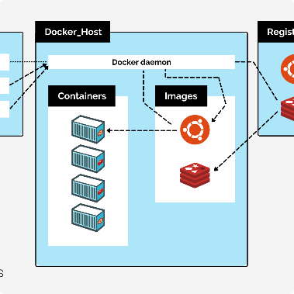
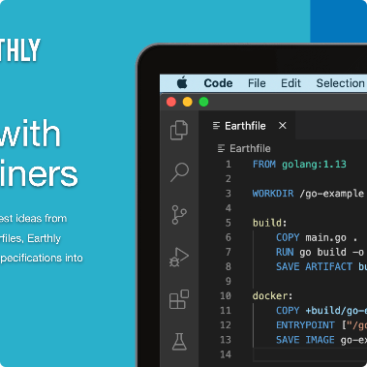
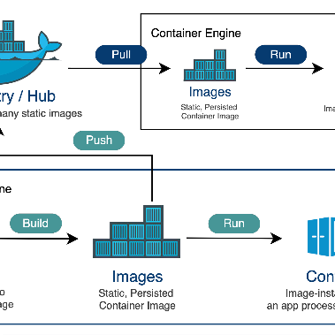
How Docker Works
Architecture
Dockerfile
Docker Registry
Docker uses a client-server architecture, where the Docker client communicates with the Docker daemon to build and run containers.
A Dockerfile is a script that defines how to build a Docker image. It specifies the base image, adds files, and runs commands to configure the container.
Docker images can be stored in a private or public registry, which makes it easy to share images across teams and environments.

Slide 5
Creating Docker Containers
Docker run
Docker build
Docker compose
The docker run command is used to create and run a new container from a Docker image.
The docker build command is used to build a Docker image from a Dockerfile.
Docker-compose allows developers to define and run multi-container applications.
Docker swarm
Docker Swarm is used to manage and deploy multi-node Docker clusters.

Slide 6
Managing Docker Containers
1
Docker logs
View the logs of a running container to help debug issues.
Docker stats
2
Monitor resource usage of running docker containers.
3
Docker exec
Execute a command inside a running container.

Slide 7
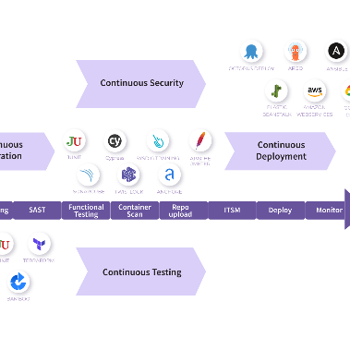
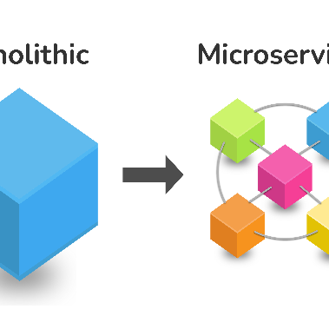
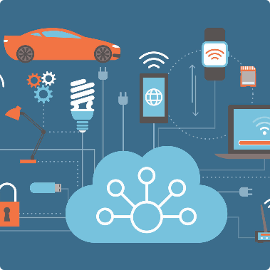
Use Cases and Practical Applications of Docker
Continuous Integration and Continuous Deployment (CI/CD)
Microservices
IoT Devices
Docker can be used to easily create and manage microservices-based architectures.
Docker can be used to create lightweight, efficient, and secure applications for IoT devices.
Docker can be used to create consistent environments across different stages of a CI/CD pipeline.

Slide 8
Conclusion
Getting Started
Learning More
Docker is easy to get started with. The official documentation and tutorials can get you up and running quickly.
Docker allows for an extensive range of customizations, from building your own base images to using orchestration tools like Kubernetes.

